Slide 1
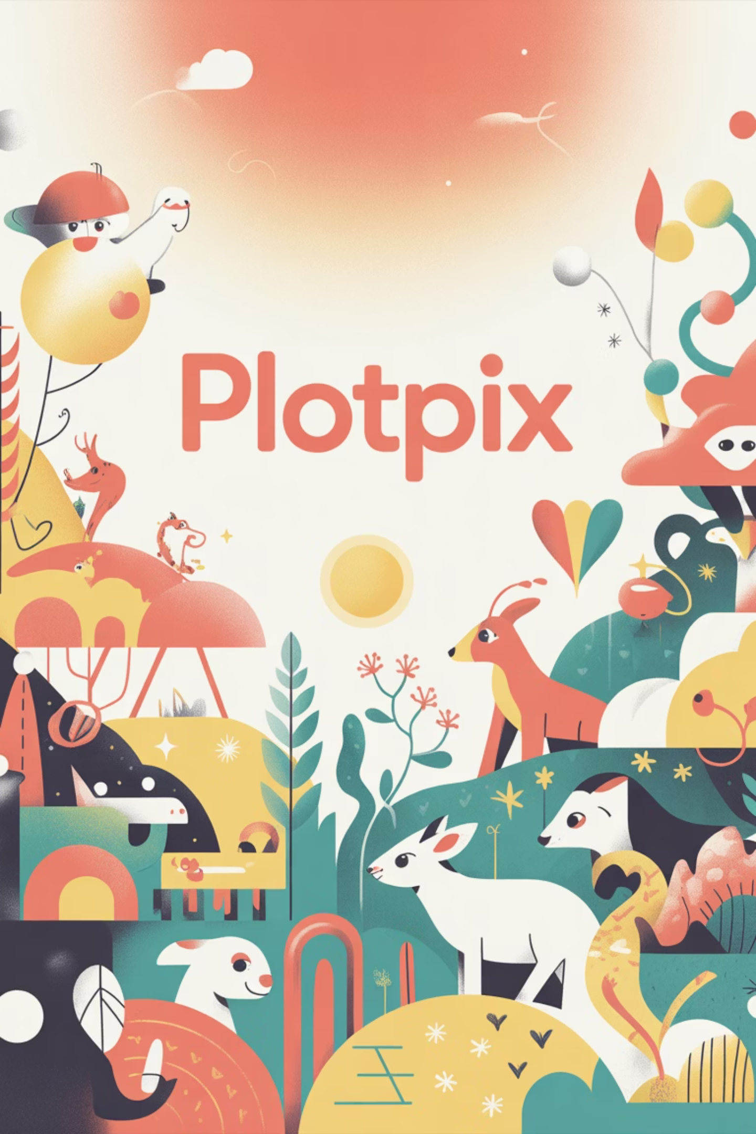
PlotPix: Interactive Children's Picture Book Generator
Unlocking boundless imagination with AI-powered storytelling for kids, crafted during a hackathon.

Slide 2
HACKATHON HIGHLIGHT
The Hackathon Spark: From Idea to Innovation
Intense Challenge
Gemini's Power
Personalized Stories
Created during an intense hackathon challenge to revolutionize children's storytelling.
Leveraged cutting-edge Google Gemini AI to build a fully interactive picture book generator.
Our goal: Empower parents, educators, and kids to create personalized stories instantly.

Slide 3

What is PlotPix?
PlotPix is an innovative AI-powered tool that generates unique, illustrated children’s picture books on demand.
It leverages Google Gemini’s advanced story and image generation capabilities.
Interactive features allow kids to engage with stories in new, immersive ways, fostering a love for reading.

Slide 4
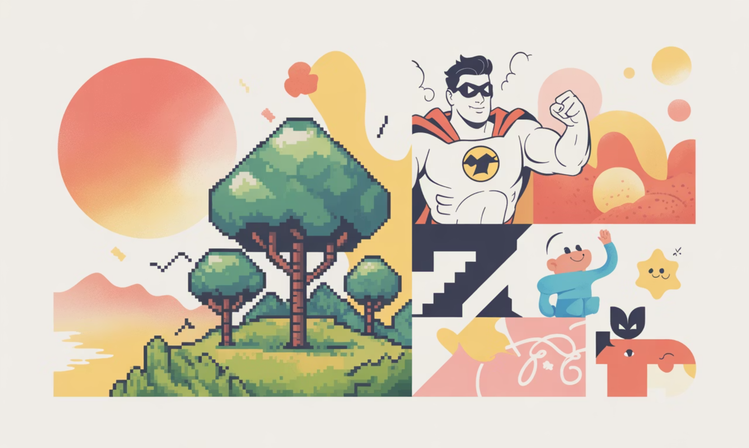

How Google Gemini Makes the Magic Happen
Instant Storybooks
Gemini AI crafts complete 10-page storybooks from simple text prompts in seconds.
Custom Illustrations
Generates custom illustrations in diverse styles: pixel art, comics, claymation, and more.
Global Reach
Supports read-aloud narration and multi-language storytelling (45+ languages).

Slide 5

Behind the Scenes: Our Development Journey
Rapid Prototyping
Overcame Challenges
Built experiments with Gemini API
Integration
Used creativity for speed & interactivity
Connected user input and flows
Our hackathon journey involved intense collaboration, problem-solving, and a deep dive into AI capabilities.

Slide 6

User Experience: Creating a Story with PlotPix
1
2
Story Idea
AI Generation
Enter a simple story idea or theme (e.g., “A brave elephant’s adventure”).
AI instantly generates text and matching illustrations for each page.
3
4
Interactive Play
Share & Enjoy
Kids interact with the story via clickable elements and read-aloud features.
Download, share, or print the personalized storybook to cherish.

Slide 7

Real Impact: Why PlotPix Matters
Fosters Literacy
Encourages early literacy and creativity in children through personalized storytelling.
Educator Support
Supports educators with easy-to-create, engaging learning materials tailored to curriculum.
New Opportunities
Opens new avenues for digital entrepreneurship in children’s content creation.

Slide 8

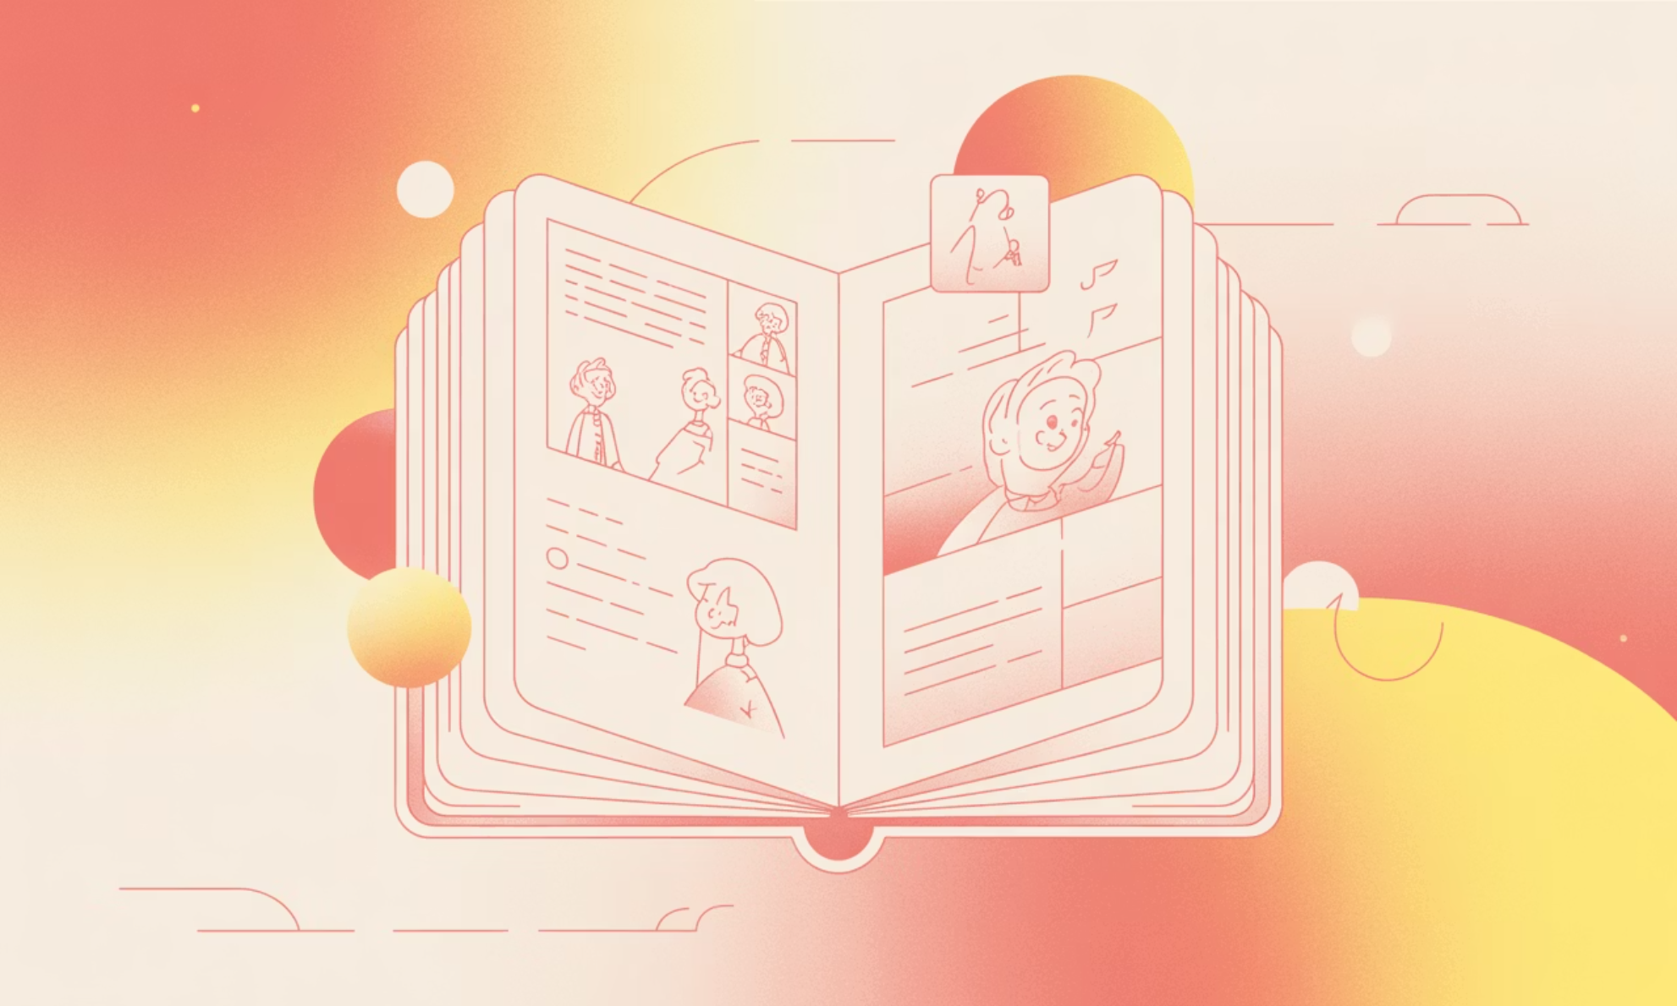
Visual Showcase: Before & After PlotPix
After: With PlotPix
Before: Traditional Creation
PlotPix delivers a fully illustrated, interactive storybook in under a minute.
Traditional storybook creation takes weeks, often requiring multiple illustrators and writers.

Slide 9




The Future of PlotPix & AI Storytelling
Enhanced Interactivity
Plans to expand interactivity with voice commands and adaptive storylines.
Strategic Partnerships
Potential partnerships with schools and leading children’s media platforms.
Continuous Evolution
Continuous improvements powered by Google Gemini’s evolving AI capabilities.

Slide 10

Join Us on This Storytelling Adventure
PlotPix is more than a tool—it’s a gateway to imagination and learning. Experience the future of children’s books powered by AI today.
Let’s create stories that inspire, educate, and delight every child, everywhere!

Slide 11



Connect with the PlotPix Team
Kousheyo Banerjee
Jayshree
LinkedIn: https://www.linkedin.com/in/kousheyo-banerjee-ab9440392/
LinkedIn: https://www.linkedin.com/in/jayshree-4b963928b/
Instagram: @lem0nade._.xyz
Instagram: @kousheyoxx._
P.S. This was our first hackathon, so your valuable feedback and suggestions are always welcome! We'd love to hear your thoughts on PlotPix.

